Slide 1
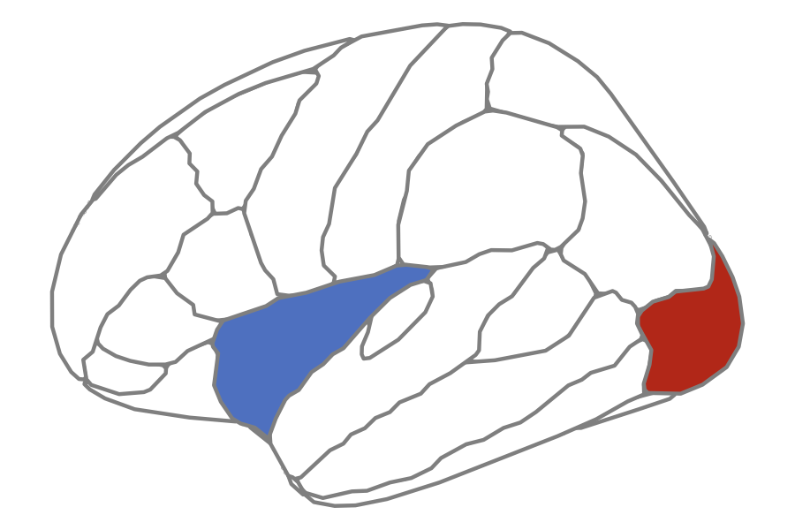
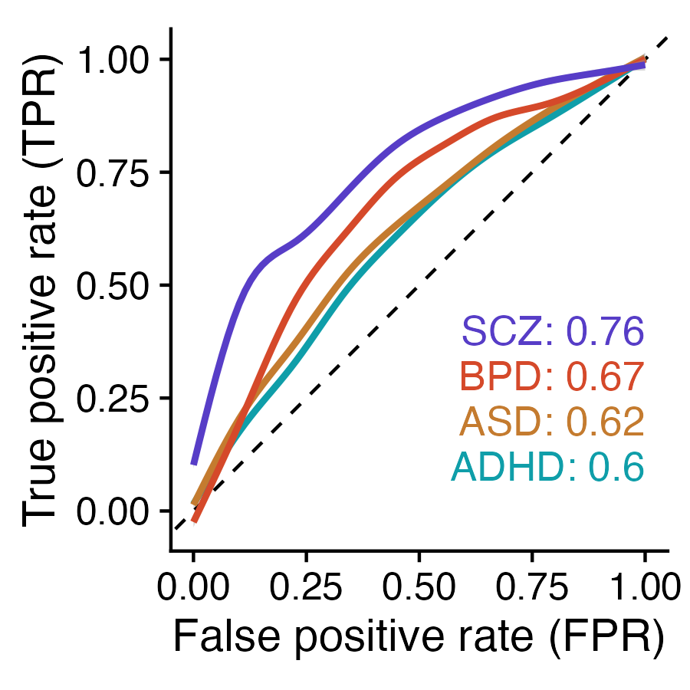
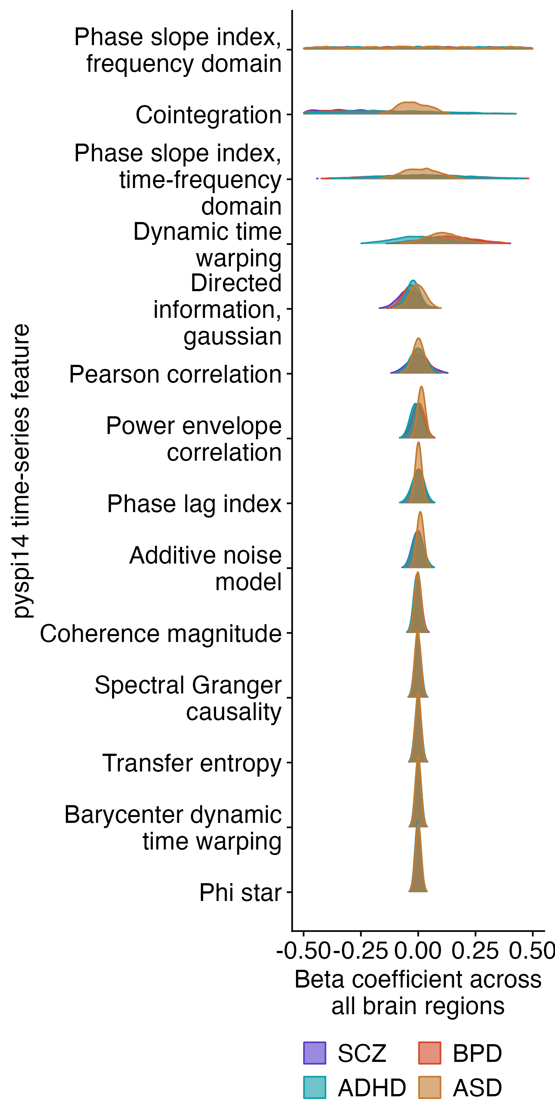
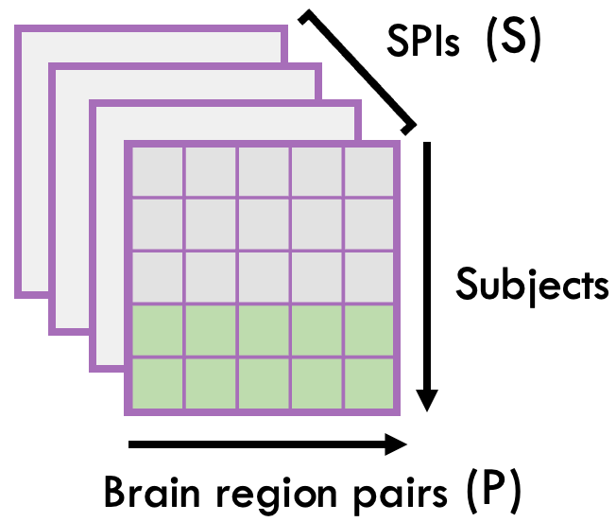

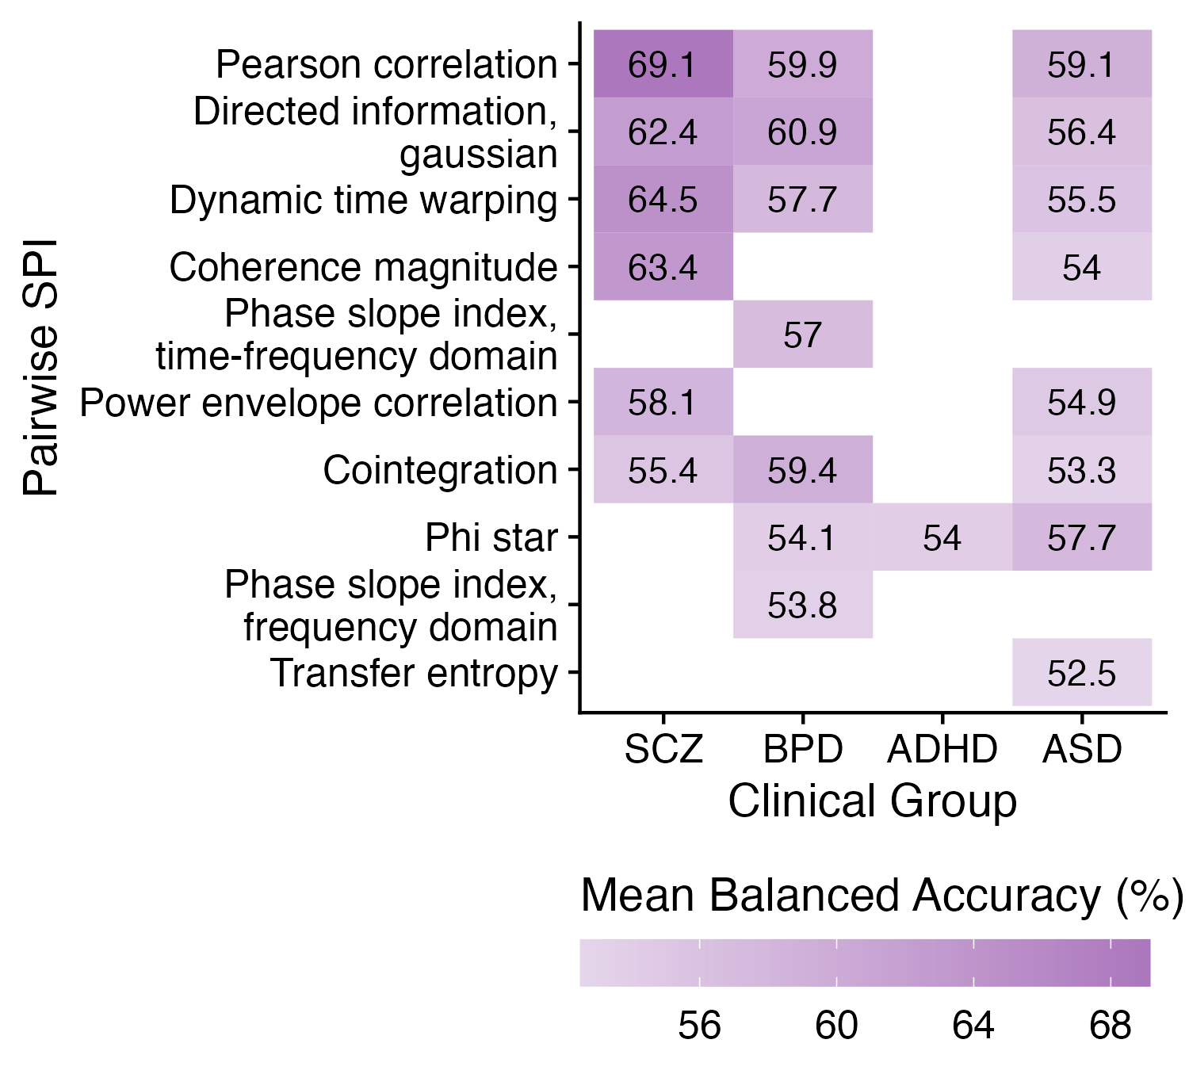
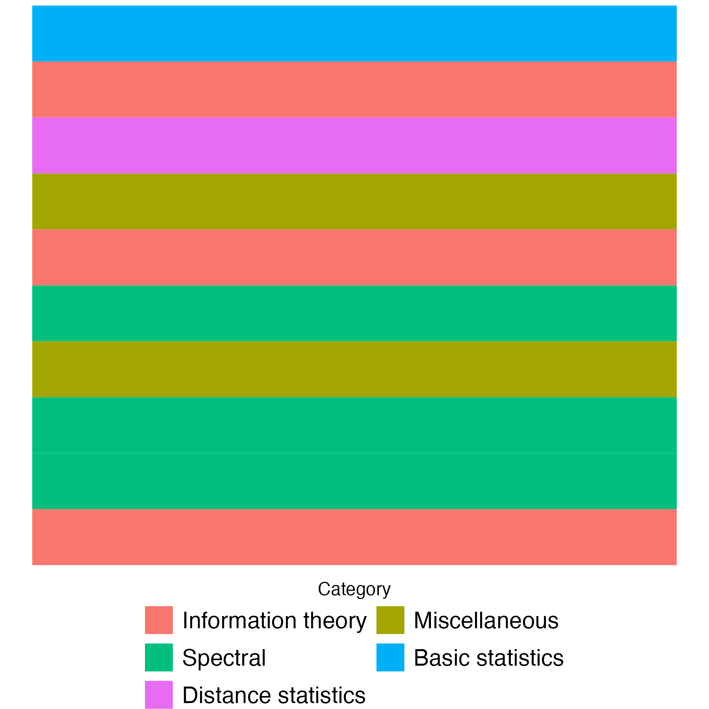
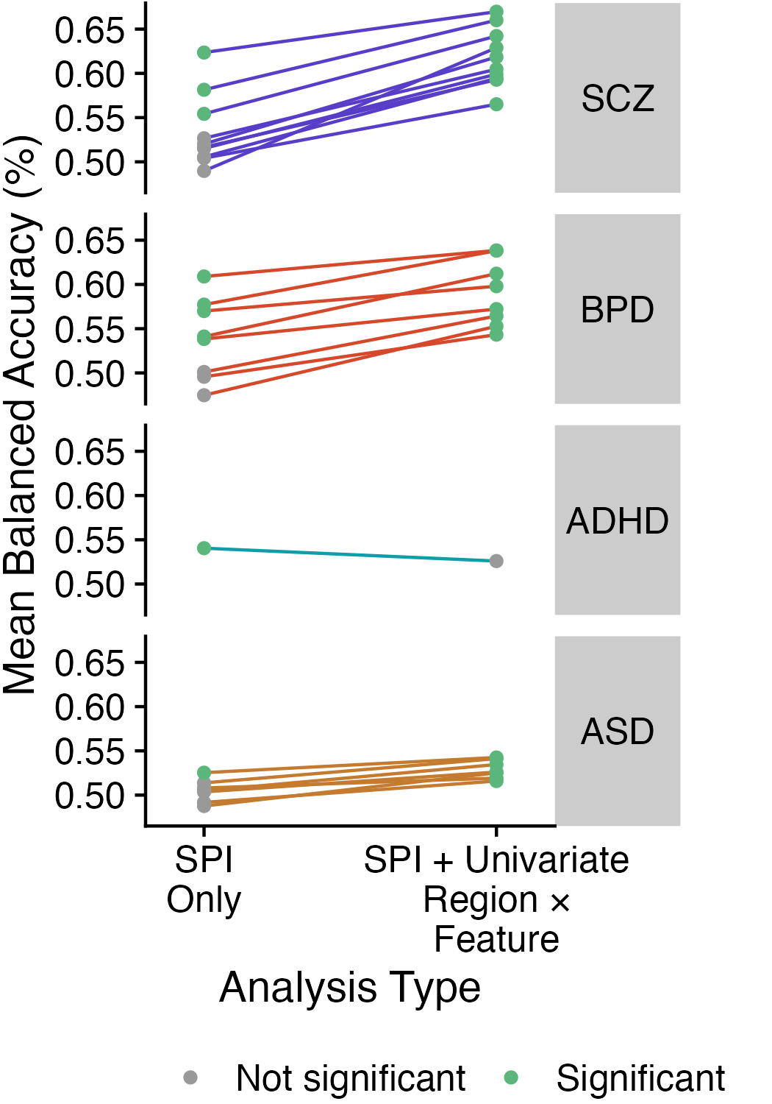

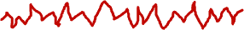
A
B
E
SPI 1
SPI 1
Repeat for all 14 SPIs
SPIs
Linear SVM
C
Mean balanced accuracy (%)
D
Notes:
Figure 2. Univariate classification results for ASD and schizophrenia. A: Results from region-based classification analysis. For ASD, the bilateral superior frontal gyrus yielded a statistically significant balanced accuracy (55.95 +/- 0.52, p=4.58e-04, BH-adjusted p=2.20e-02). For schizophrenia, the all yielded significant balanced classification accuracies. right postcentral gyrus (67.23 +/- 2.49, p=1.00e-03, BH-adjusted p=4.07e-02), right amygdala (66.82 +/- 2.12, p=1.32e-03, BH-adjusted p=4.07e-02), and left banks of the superior temporal sulcus (66.64 +/- 1.97, p=1.49e-03, BH-adjusted p=4.07e-02)

Slide 2
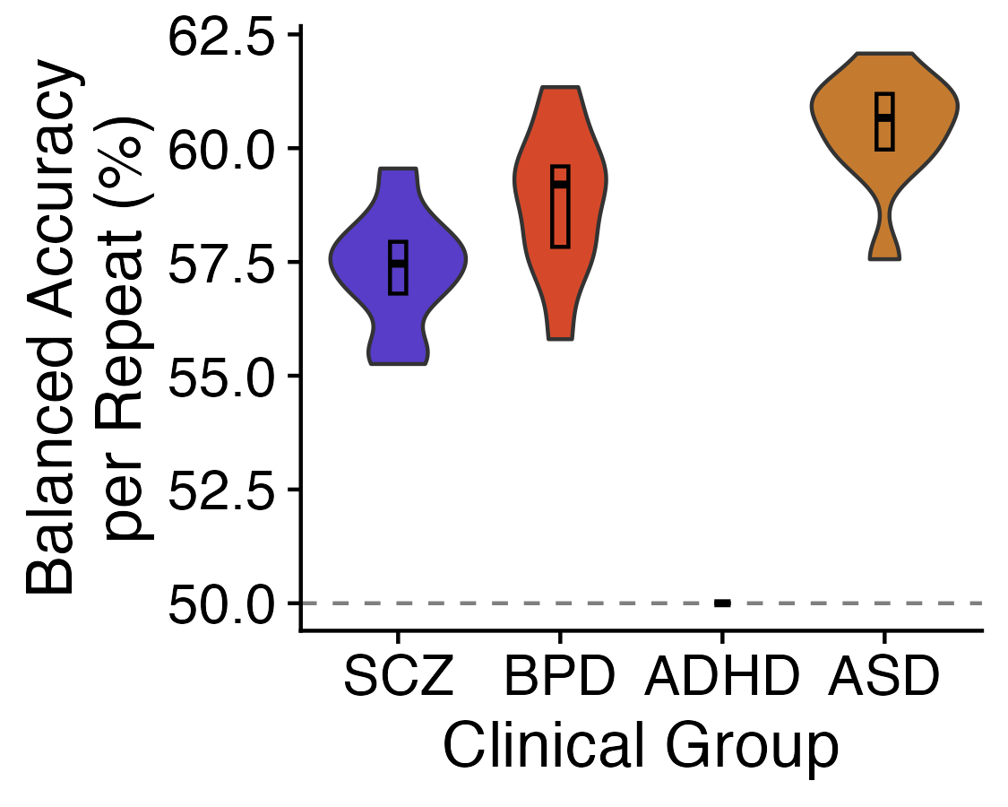
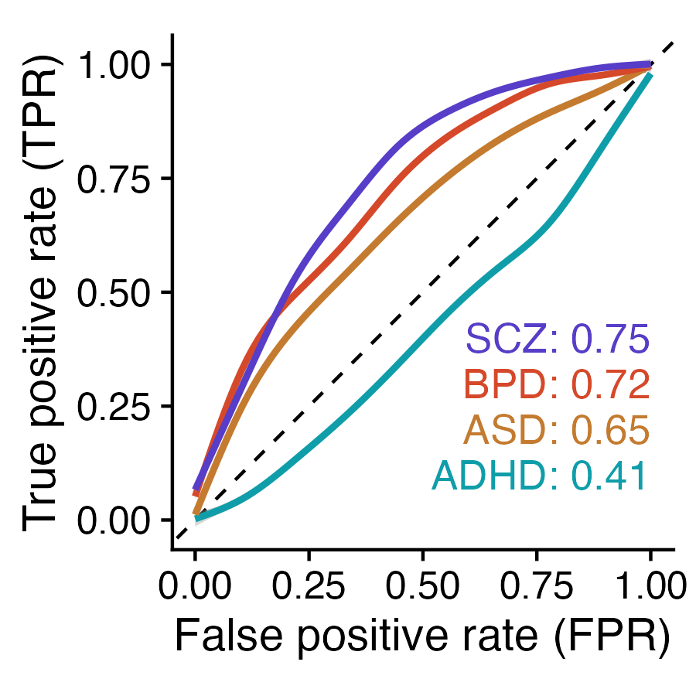
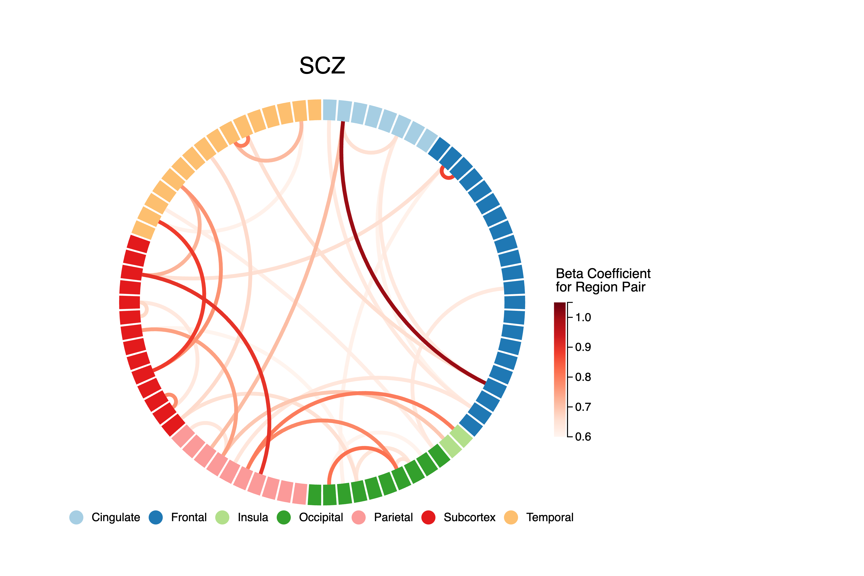
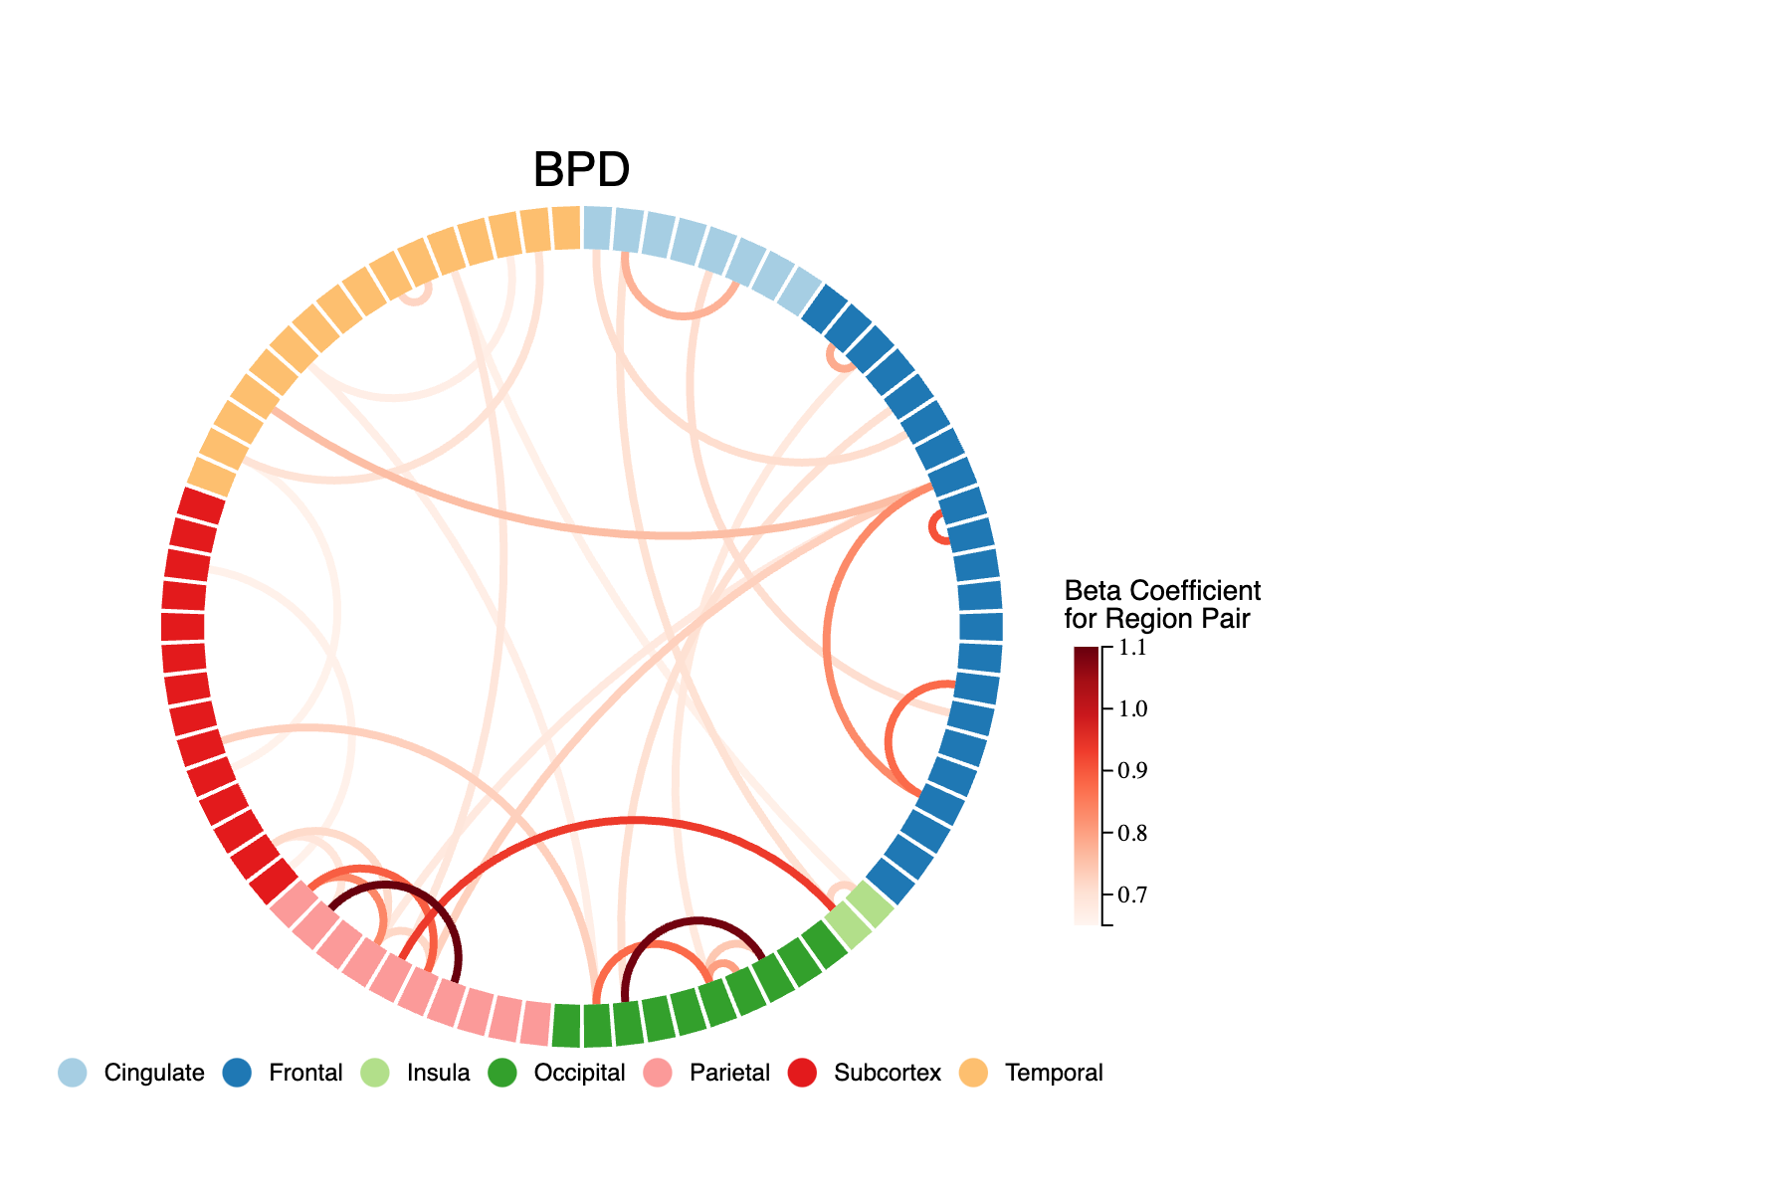
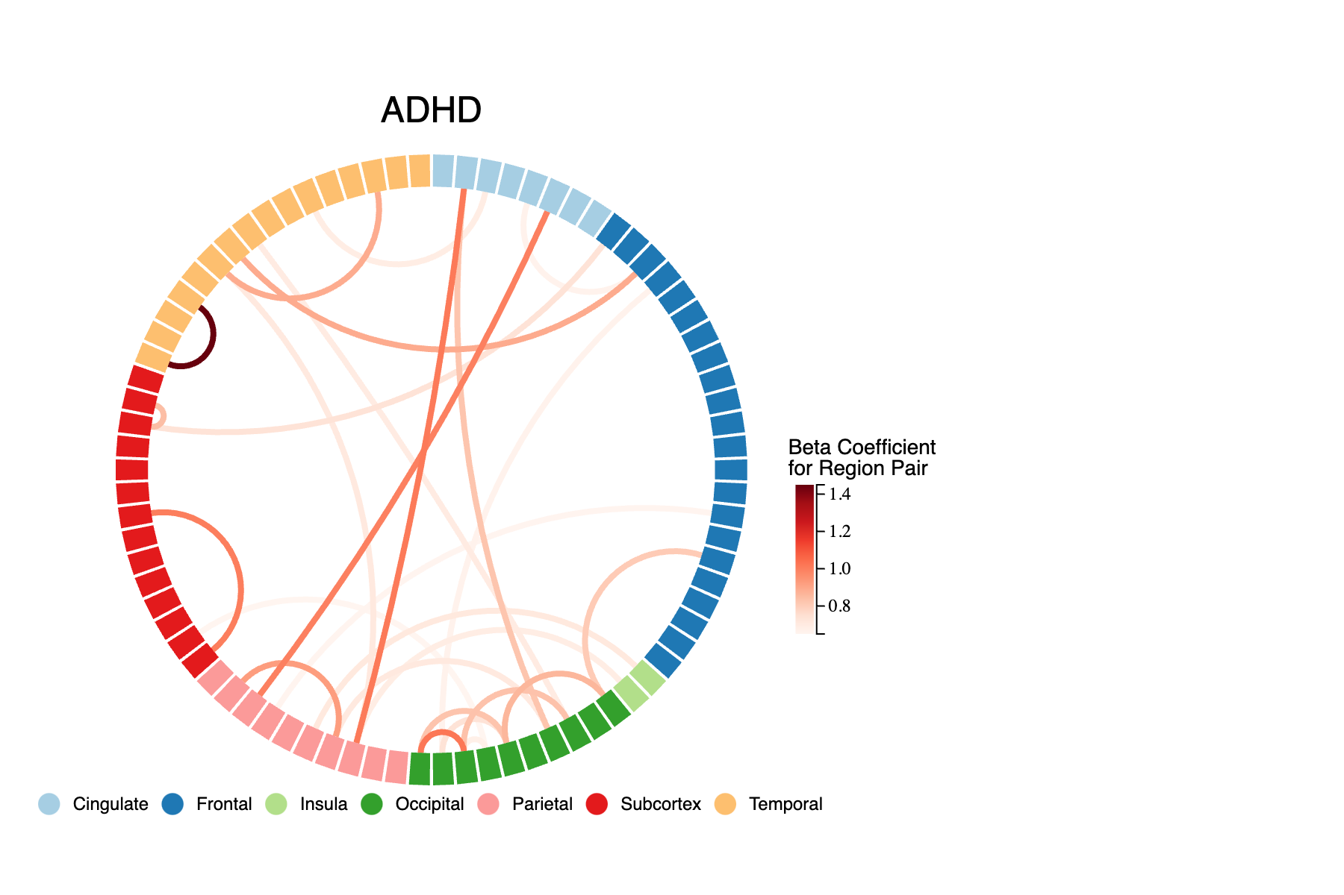
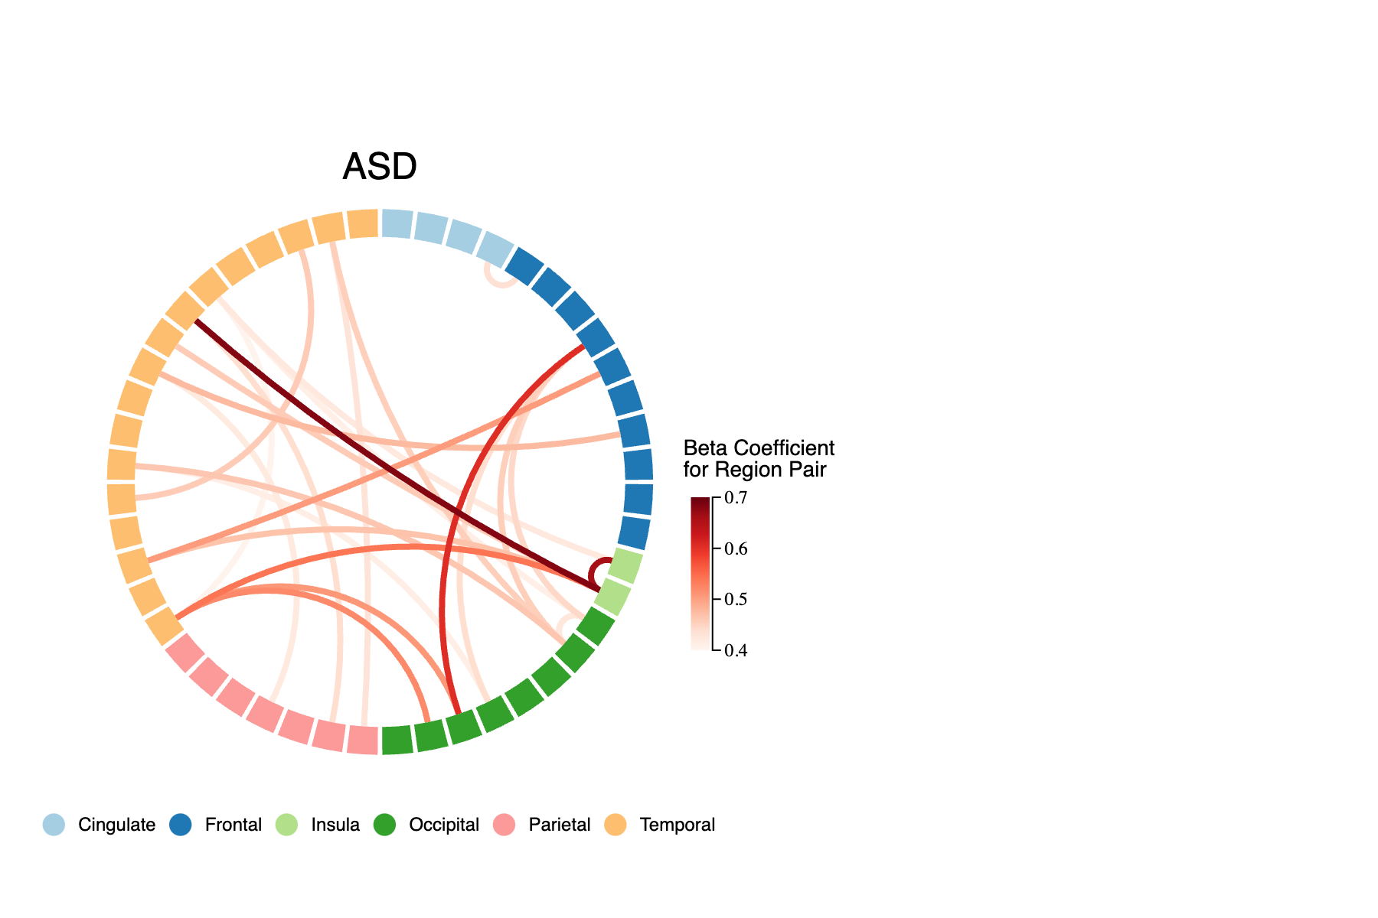
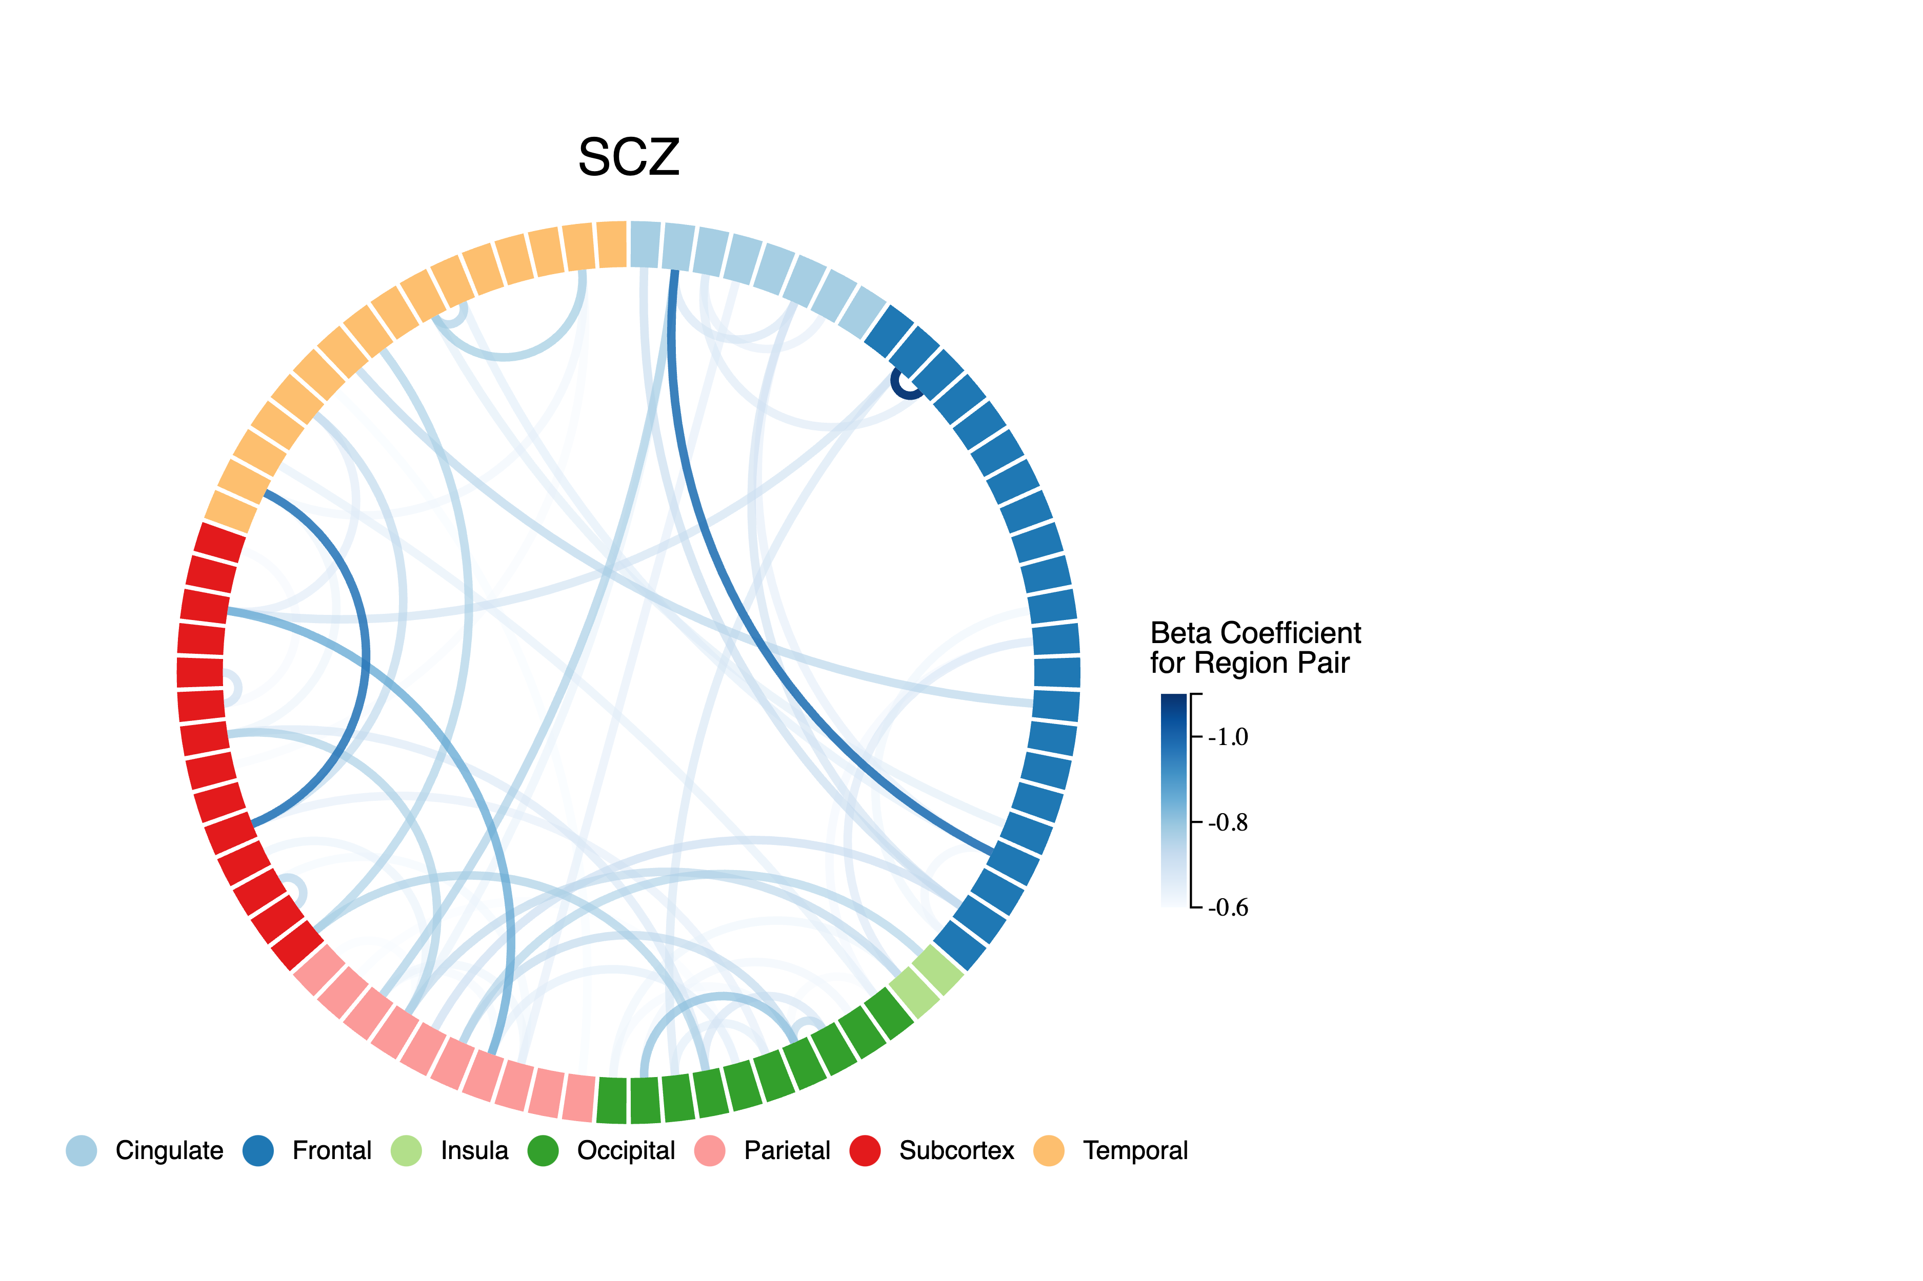
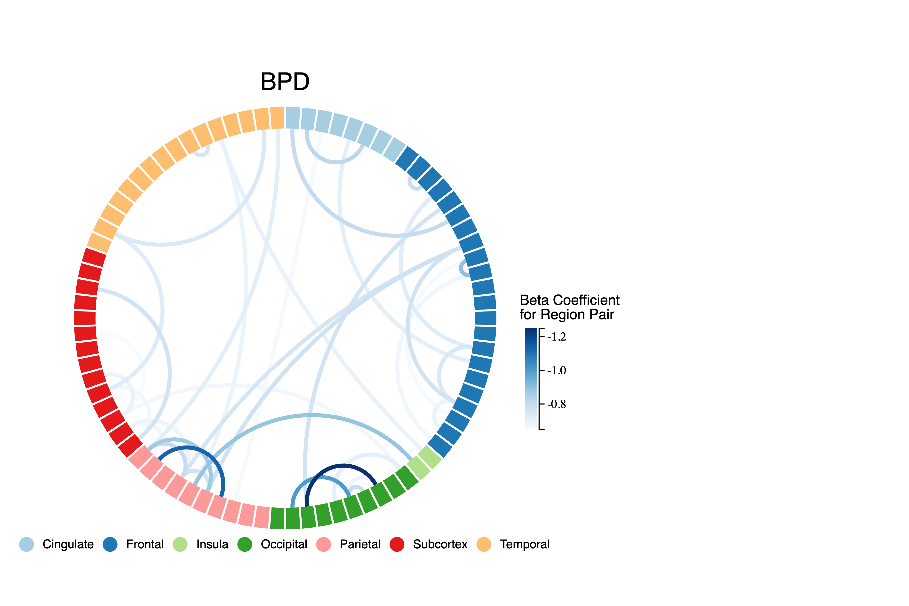
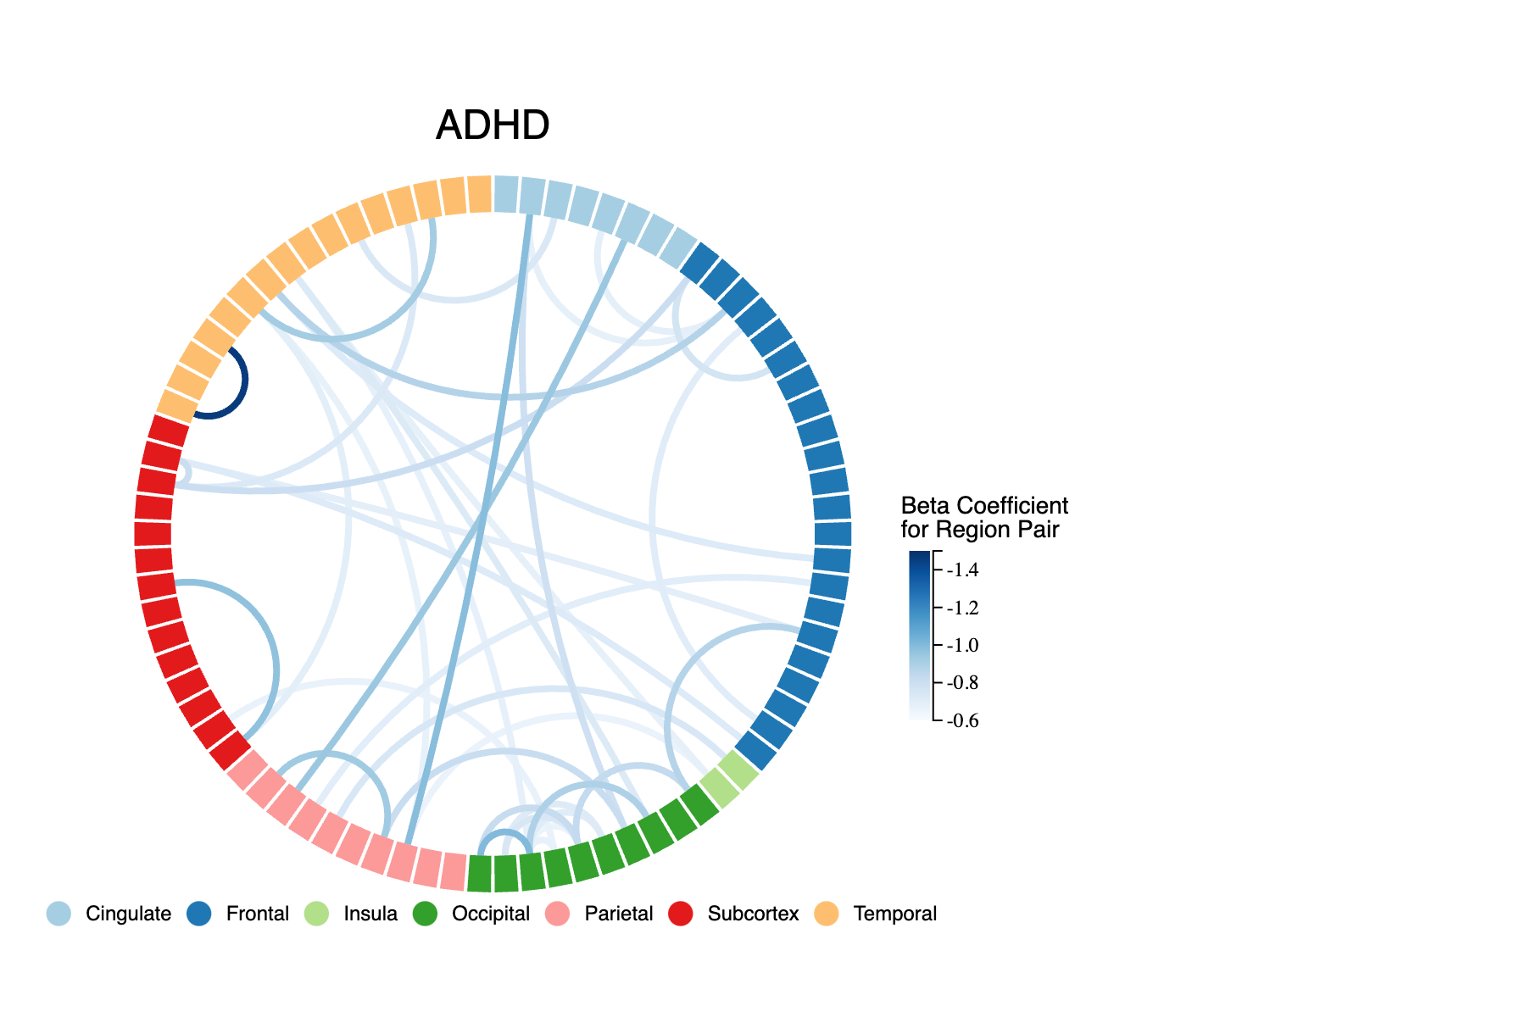
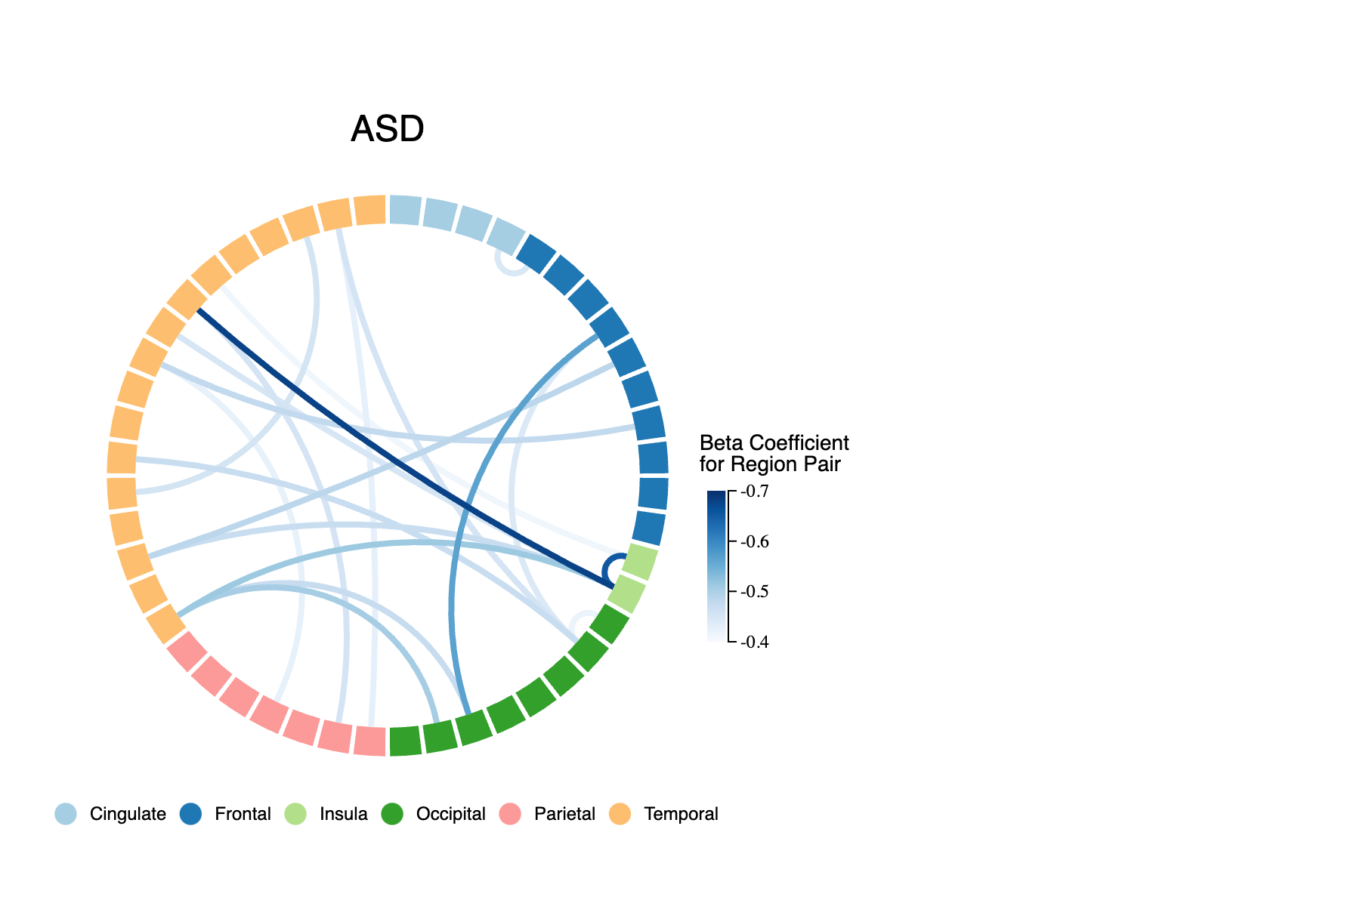
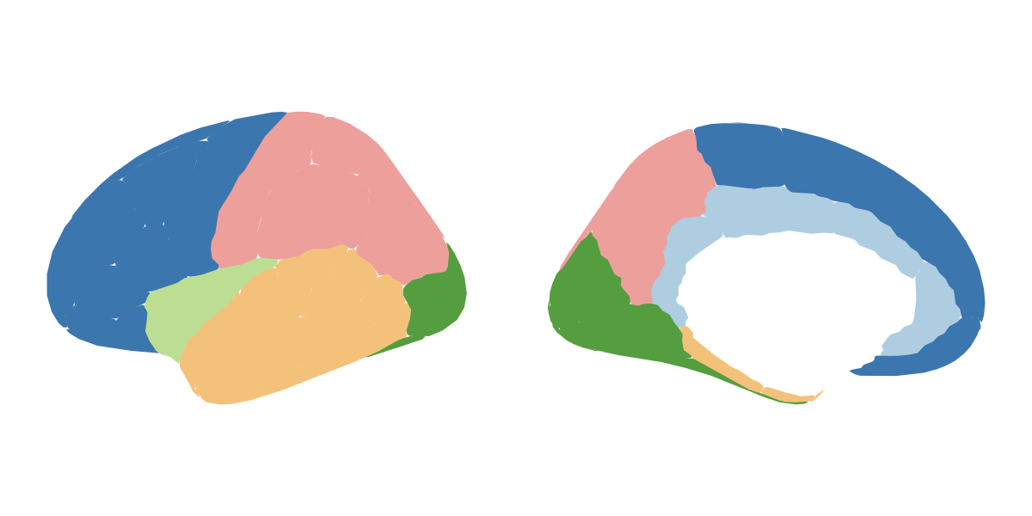
A
B
***
***
***
C
SPIs
Linear SVM
D
SCZ
BPD
ADHD
ASD
Notes:
Figure 2. Univariate classification results for ASD and schizophrenia. A: Results from region-based classification analysis. For ASD, the bilateral superior frontal gyrus yielded a statistically significant balanced accuracy (55.95 +/- 0.52, p=4.58e-04, BH-adjusted p=2.20e-02). For schizophrenia, the all yielded significant balanced classification accuracies. right postcentral gyrus (67.23 +/- 2.49, p=1.00e-03, BH-adjusted p=4.07e-02), right amygdala (66.82 +/- 2.12, p=1.32e-03, BH-adjusted p=4.07e-02), and left banks of the superior temporal sulcus (66.64 +/- 1.97, p=1.49e-03, BH-adjusted p=4.07e-02)

Slide 3
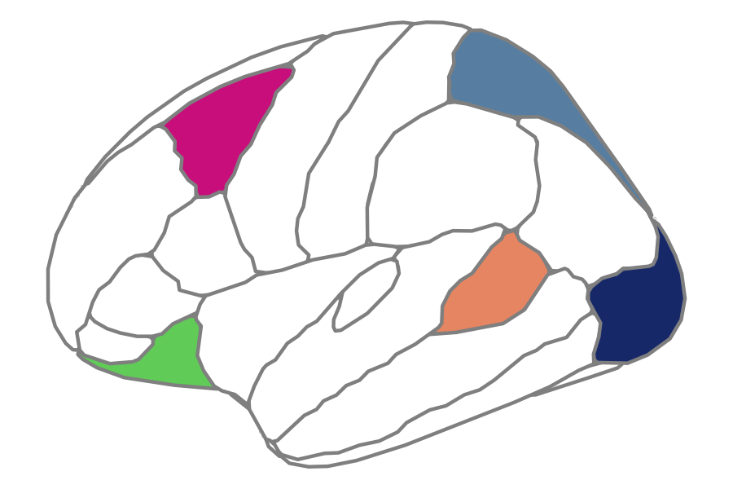
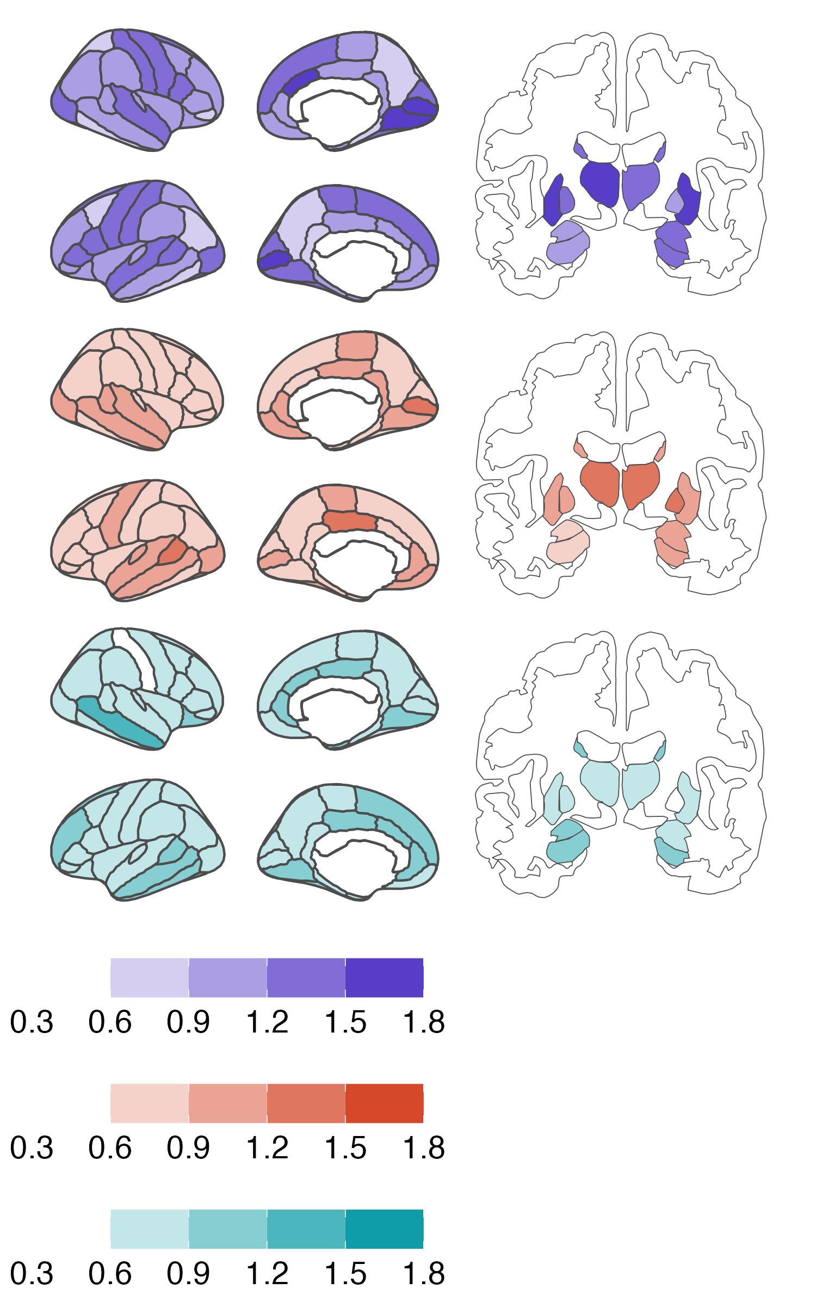
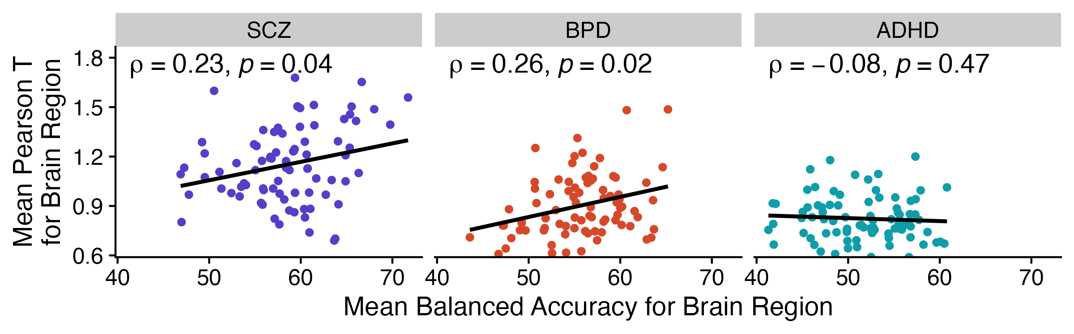
A
Subjects
r = 0.5
r = 0.9
r = 0.5
r = 0.9
r = 0.5
r = 0.9
T = 0.9
T = 2.4
|T₁| = 0.9
r = 0.5
r = 0.9
|T₂| = 2.4
T_{R}
r = 0.1
r = -0.3
|T₃| = 1.3
r = 0.1
r = -0.3
…
r = 0.1
r = -0.3
T = -1.3
r = 0.1
r = -0.3
T = 0.3
|T_{C}| = 0.3
Measure a given undirected SPI (e.g., Pearson r) for all region pairs per subject
Compute T statistic for all region pairs relative to control subjects
For each brain region R, take its average absolute T statistic from all its C connected regions
B
SCZ
BPD
ADHD
ASD
Pearson T_{R}
Pearson T_{R}
Pearson T_{R}
Pearson T_{R}
C

Slide 4
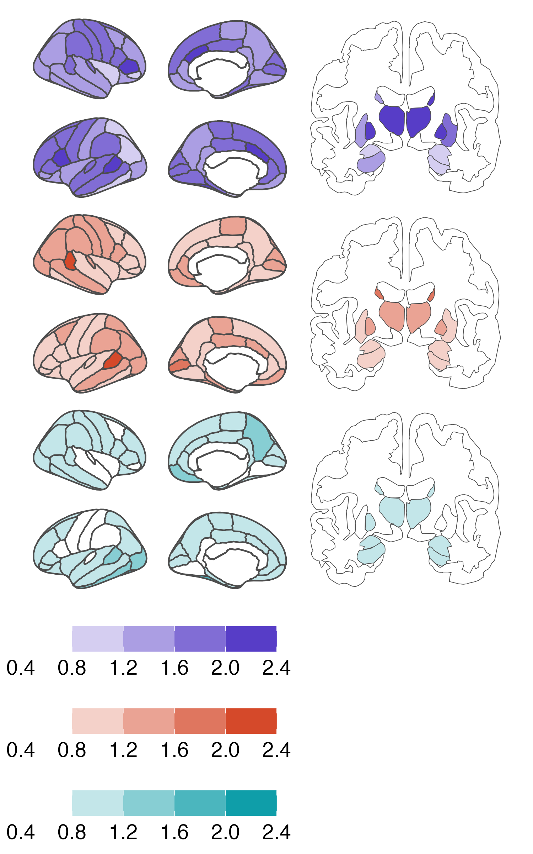
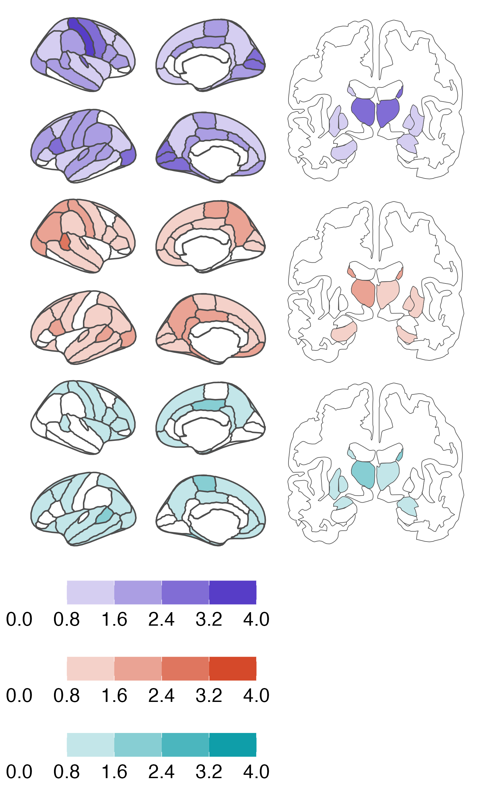
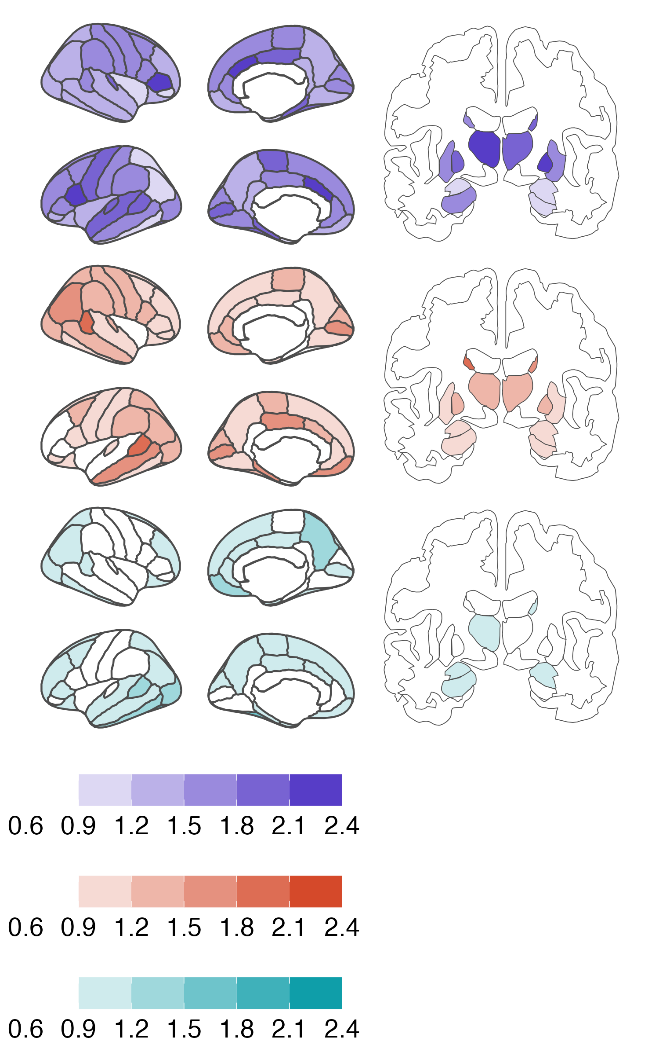
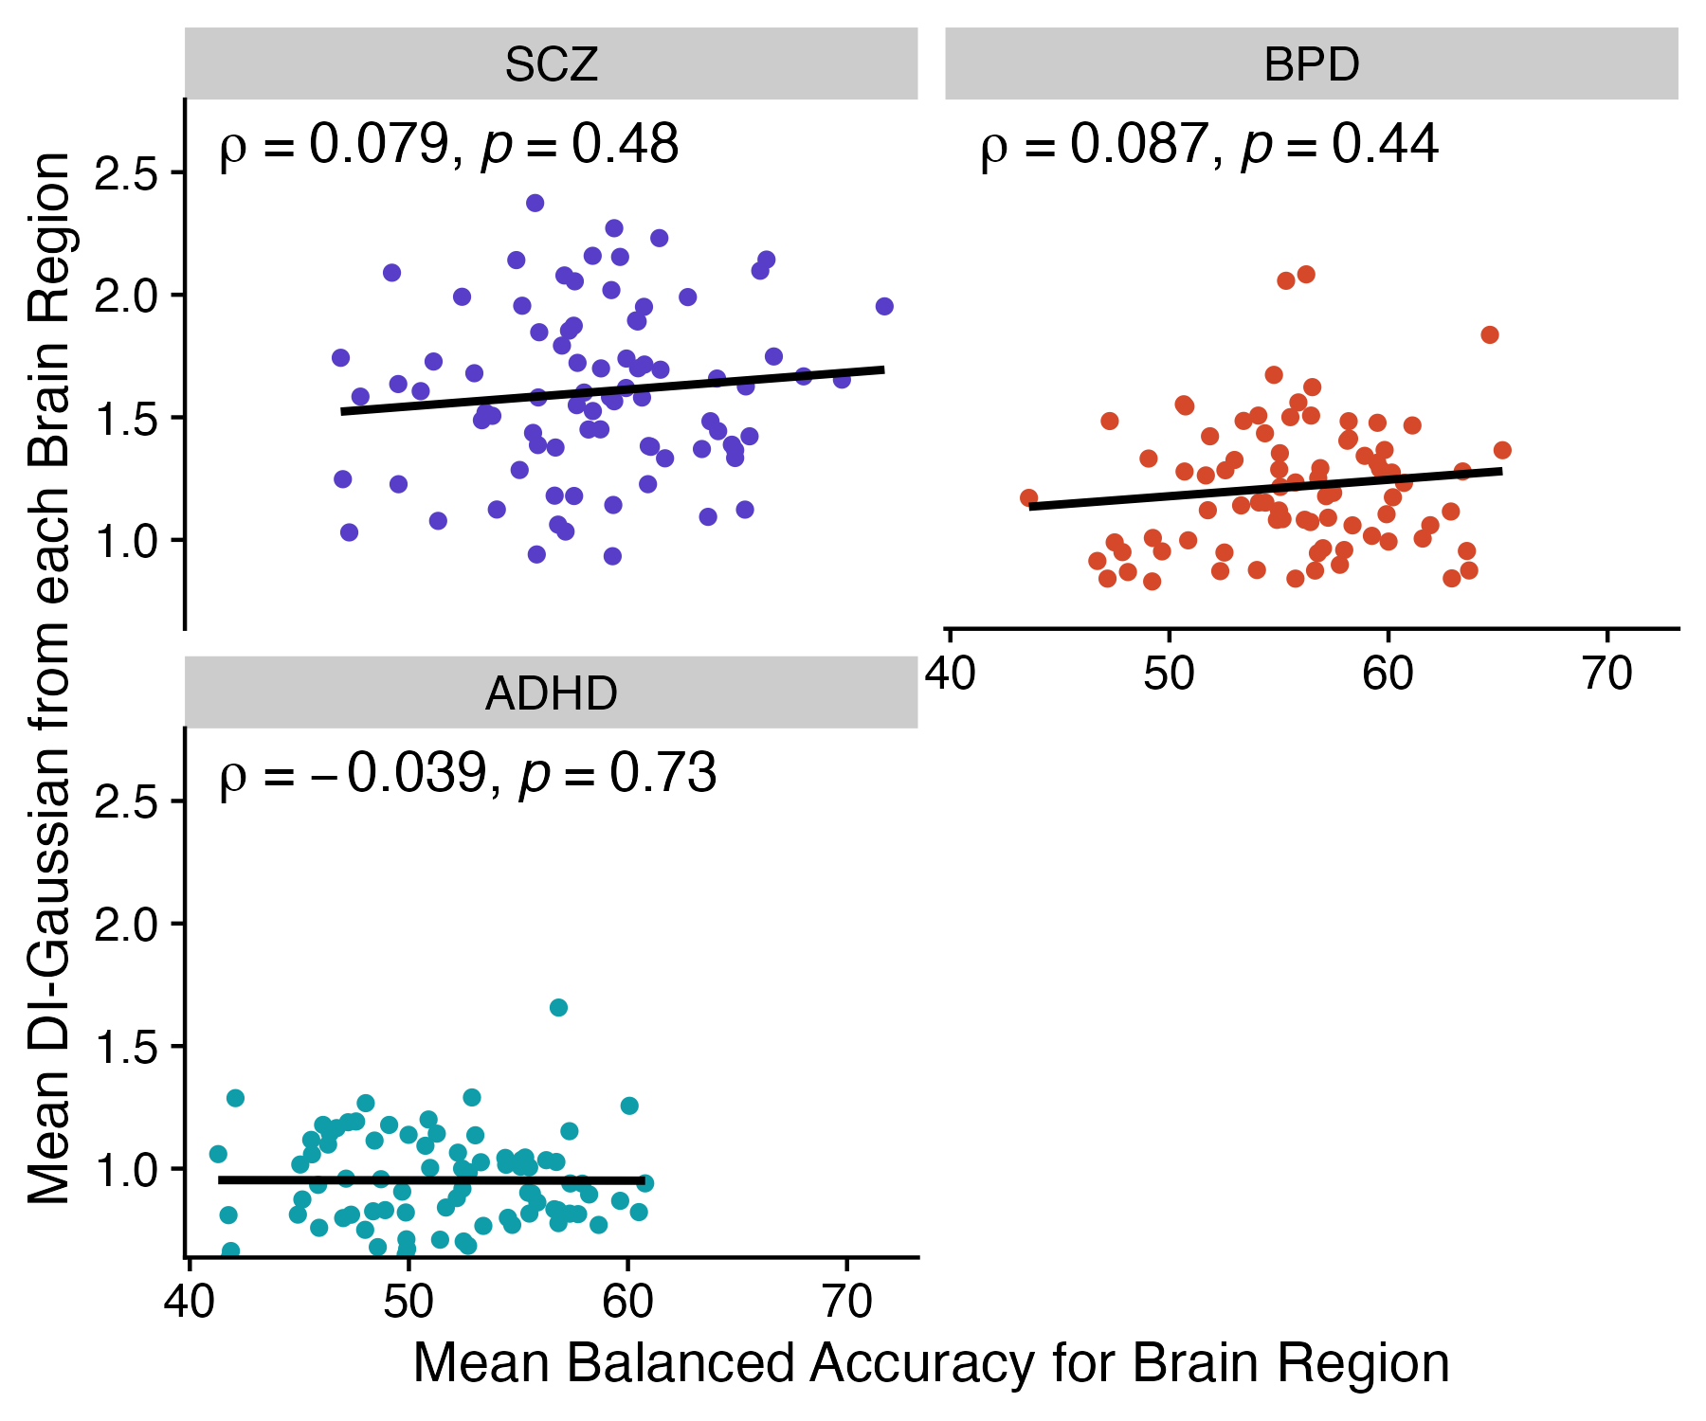
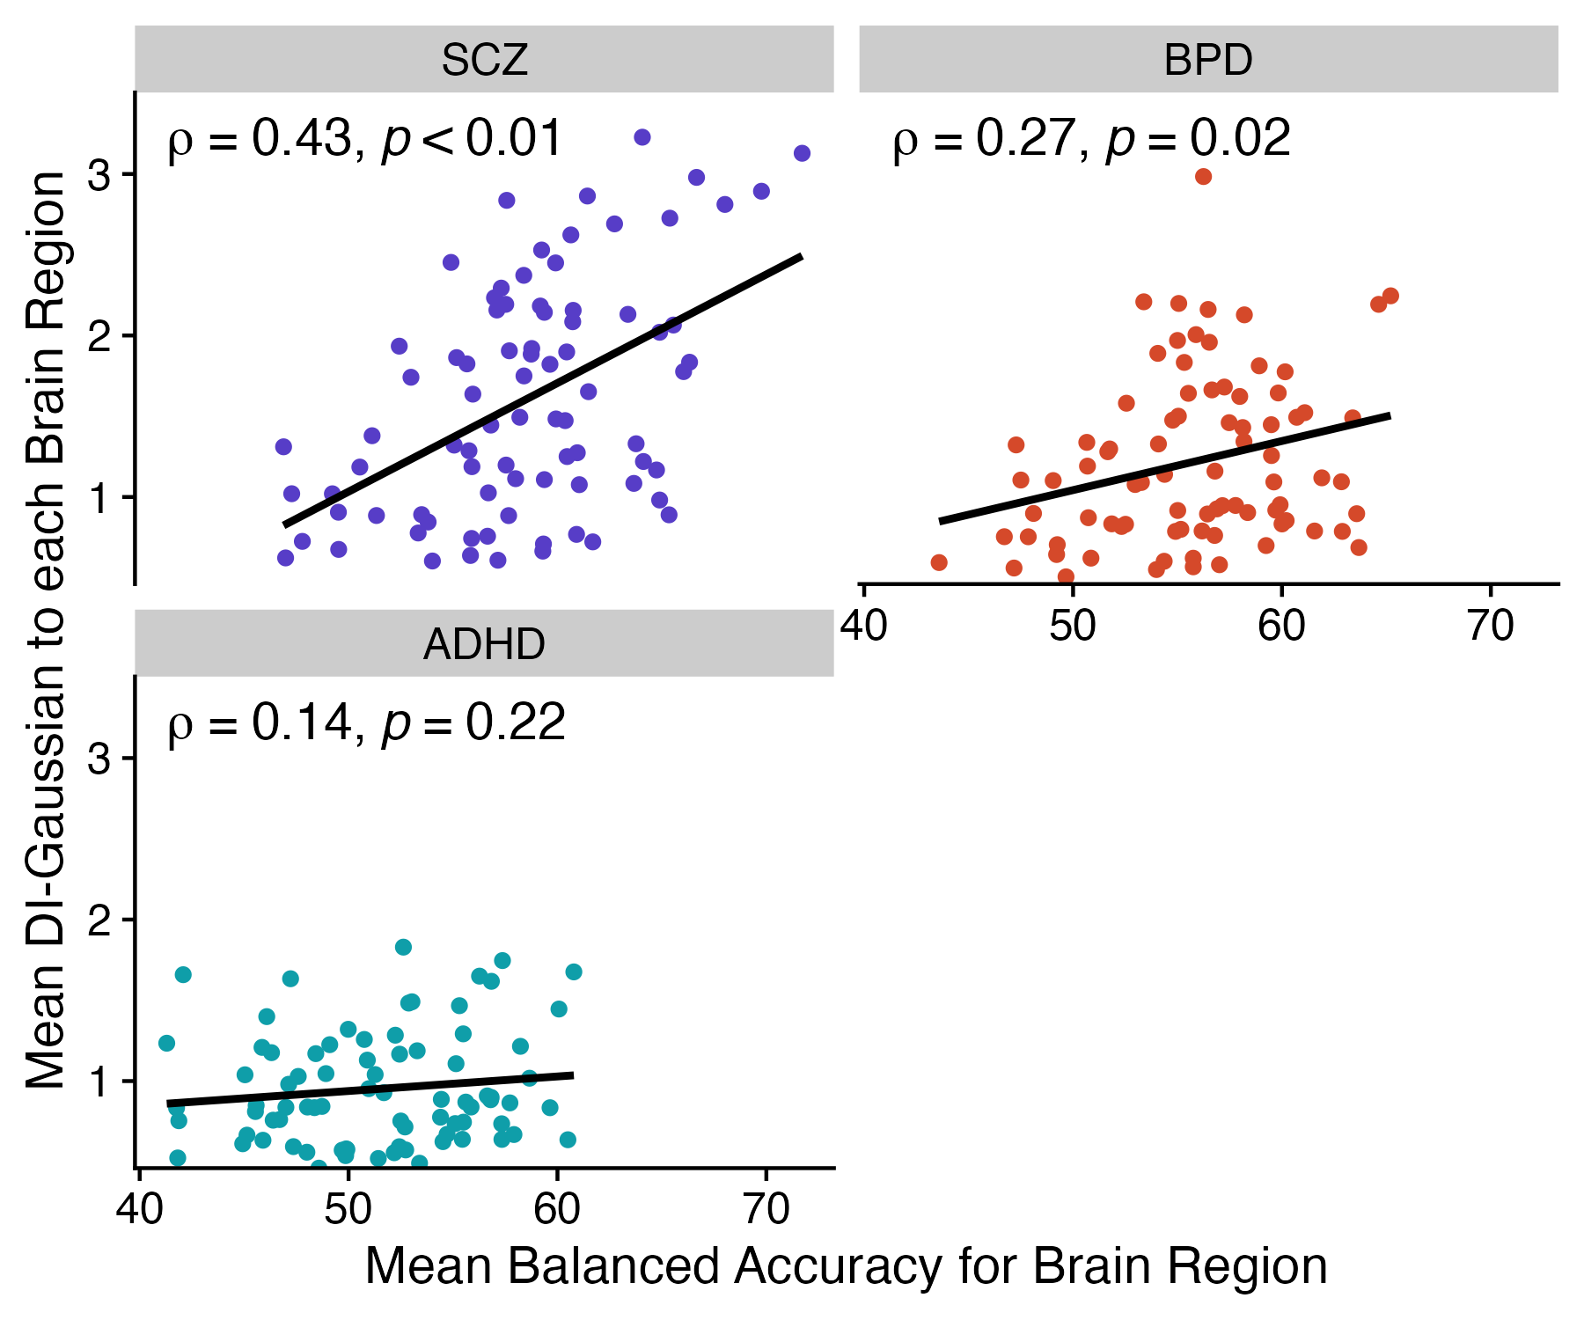
A
DI_{from} = 0.5
Subjects
DI_{from} = 0.5
DI_{from} = 0.9
DI_{from} = 0.5
DI_{from} = 0.9
DI_{from} = 0.5
DI_{from} = 0.9
T_{from} = 0.9
T_{from} = 2.4
|T_{1,from}| = 0.9
DI_{from} = 0.9
|T_{2,from}| = 2.4
DI_{from} = 0.1
DI_{from} = -0.3
|T_{3,from}| = 1.3
T_{R,from}
DI_{from} = 0.1
DI_{from} = -0.3
…
DI_{from} = 0.1
DI_{from} = -0.3
T_{from} = -1.3
|T_{C,from}| = 0.3
DI_{from} = 0.1
DI_{from} = -0.3
T_{from} = 0.3
Measure a given directed SPI (e.g., directed information) for all region pairs per subject
Compute T statistic for all region pairs relative to control subjects
For each brain region R, take its average absolute T statistic to or from all its connections to C connected regions
SCZ
BPD
SCZ
BPD
B
C
DI-from T_{R}
DI-from T_{R}
DI-to T_{R}
DI-to T_{R}
ADHD
ASD
ADHD
ASD
DI-from T_{R}
DI-from T_{R}
DI-to T_{R}
DI-to T_{R}
D
E

Slide 5
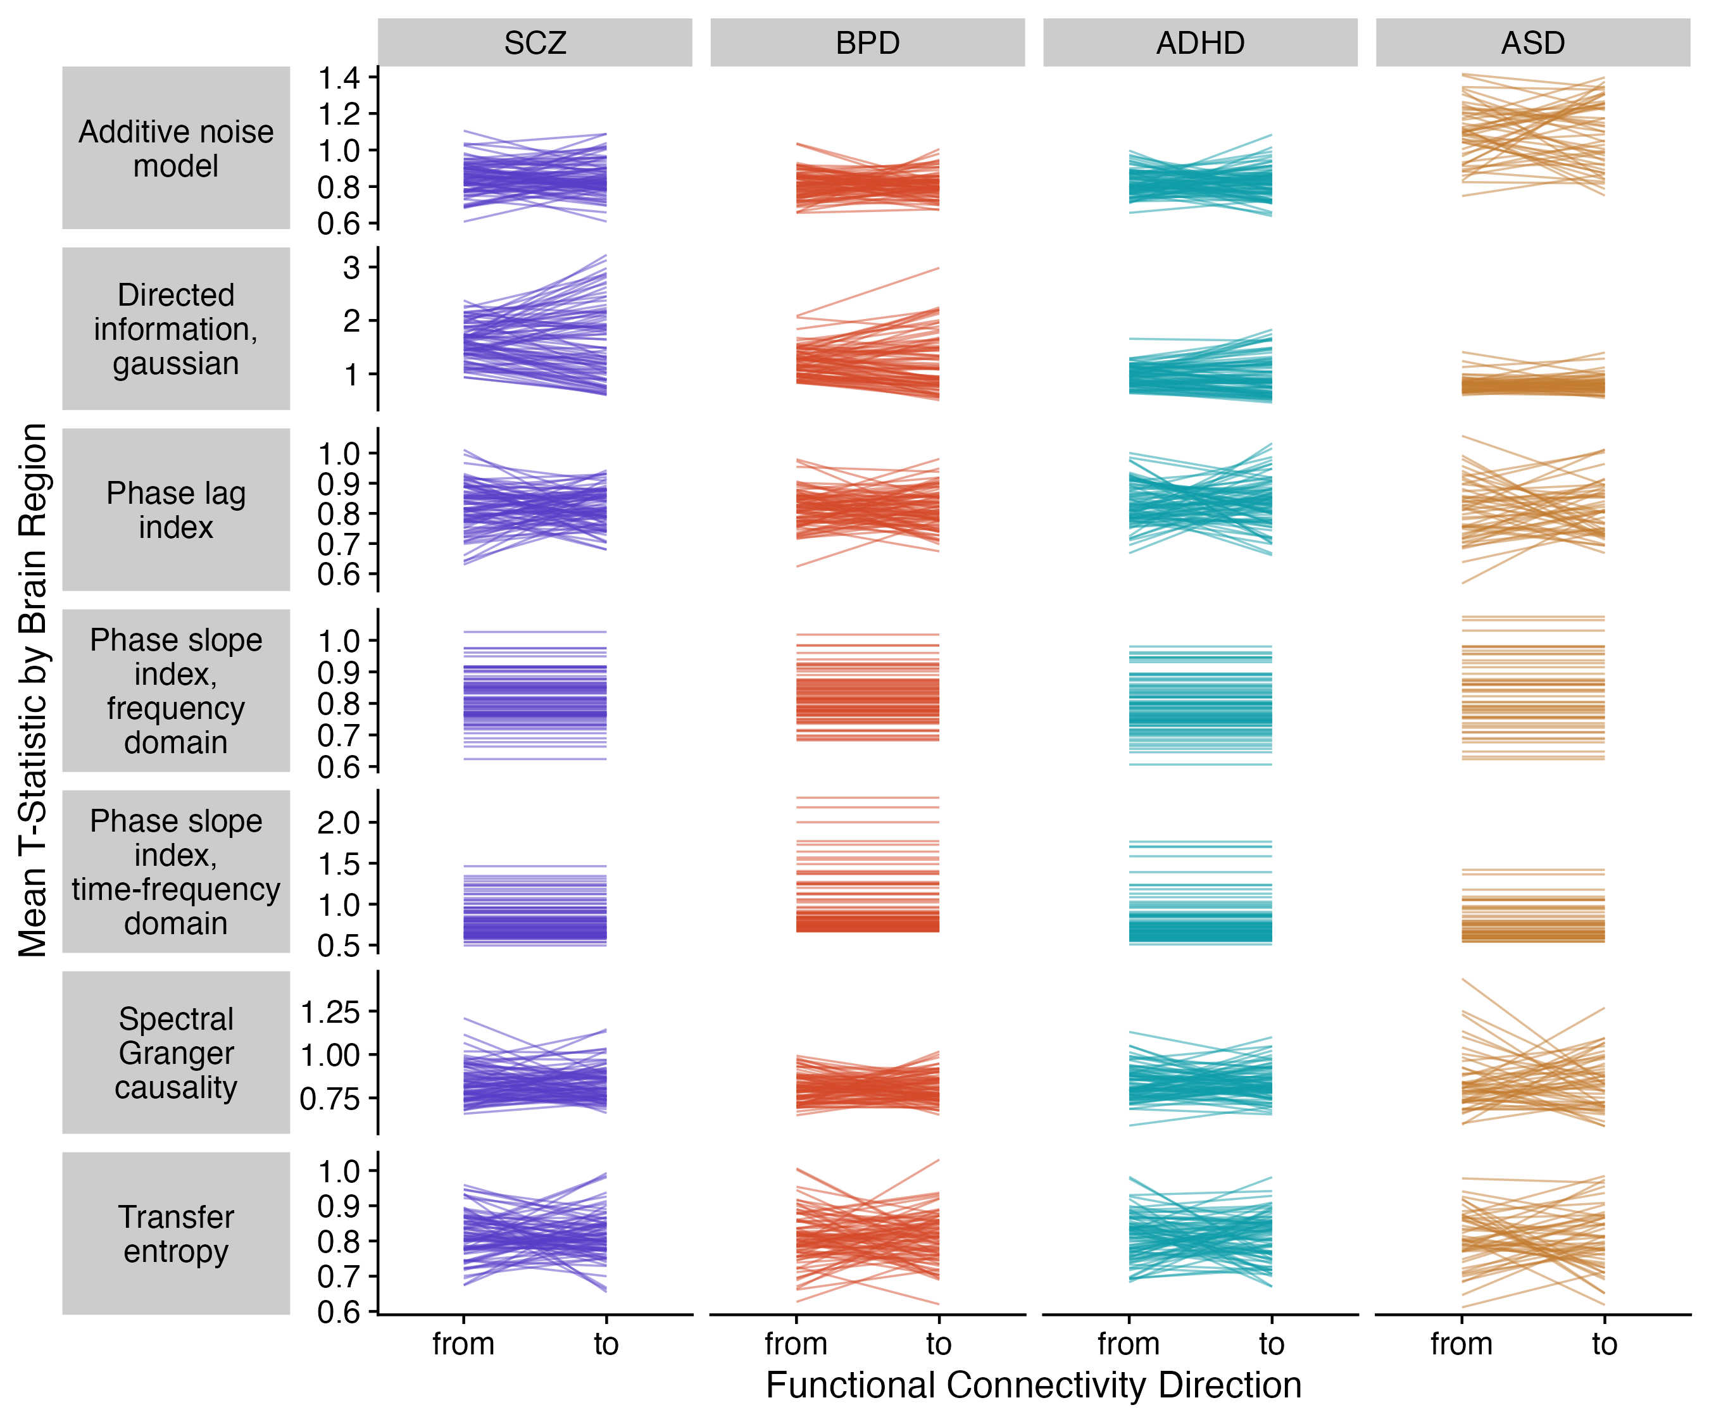
For the two phase slope index SPIs, the values to vs. from a region are the same magnitude but opposite sign – so each region’s T statistic magnitudes are identical

